Slide 1
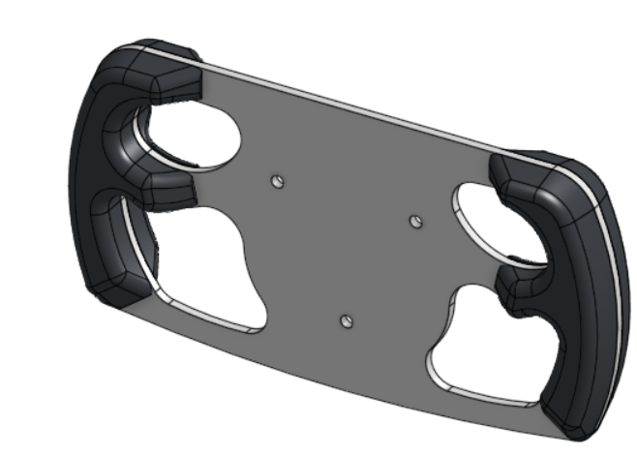
Brergo Recruitment Project
Steering Wheel Design

Slide 2
Objectives
Safe: Rule-compliant and structurally capable of carrying driver input loads
Ergonomic: Comfortable and controllable for a wide range of drivers wearing gloves
Lightweight: Material removed where it does not contribute efficiently to the load path
Manufacturable: Realistic to machine, assemble, inspect, and maintain with team resources
Validated: Design decisions supported by calculations, FEA, and physical testing plans

Slide 3
Design Question: How can I remove as much unnecessary material as possible without compromising strength, stiffness, ergonomics, or rule compliance?

Slide 4
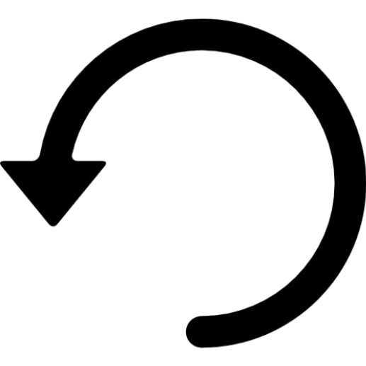
Engineering Design Process
01
02
03
04
05
Analyze, Diagnose, & Revise
Final Validation
List Requirements
Research & Concepts
Initial
Design

Slide 5
Engineering Requirements
Requirement | Design Response | Verification
Continuous compliant perimeter | Continuous non-concave outer profile | CAD + rule review
Quick disconnect | 3-bolt Lifeline QR interface | Assembly CAD
Gloved operation | Open Center + unobstructed QR access | Ergonomic prototype
Wide driver accommodation | Large finger clearance + shaped grip regions | Multi-user glove test
Structural integrity | 4 mm 7075-T6 load-bearing plate | FEA + proof test
Low mass | Internal lightening cutouts | CAD mass comparison
Steering stiffness | Geometry aligned with main load paths | FEA displacement
Manufacturability | Mostly planar aluminum structure | Manufacturing plan
Serviceability | Replaceable grips + accessible fasteners | Assembly review

Slide 6
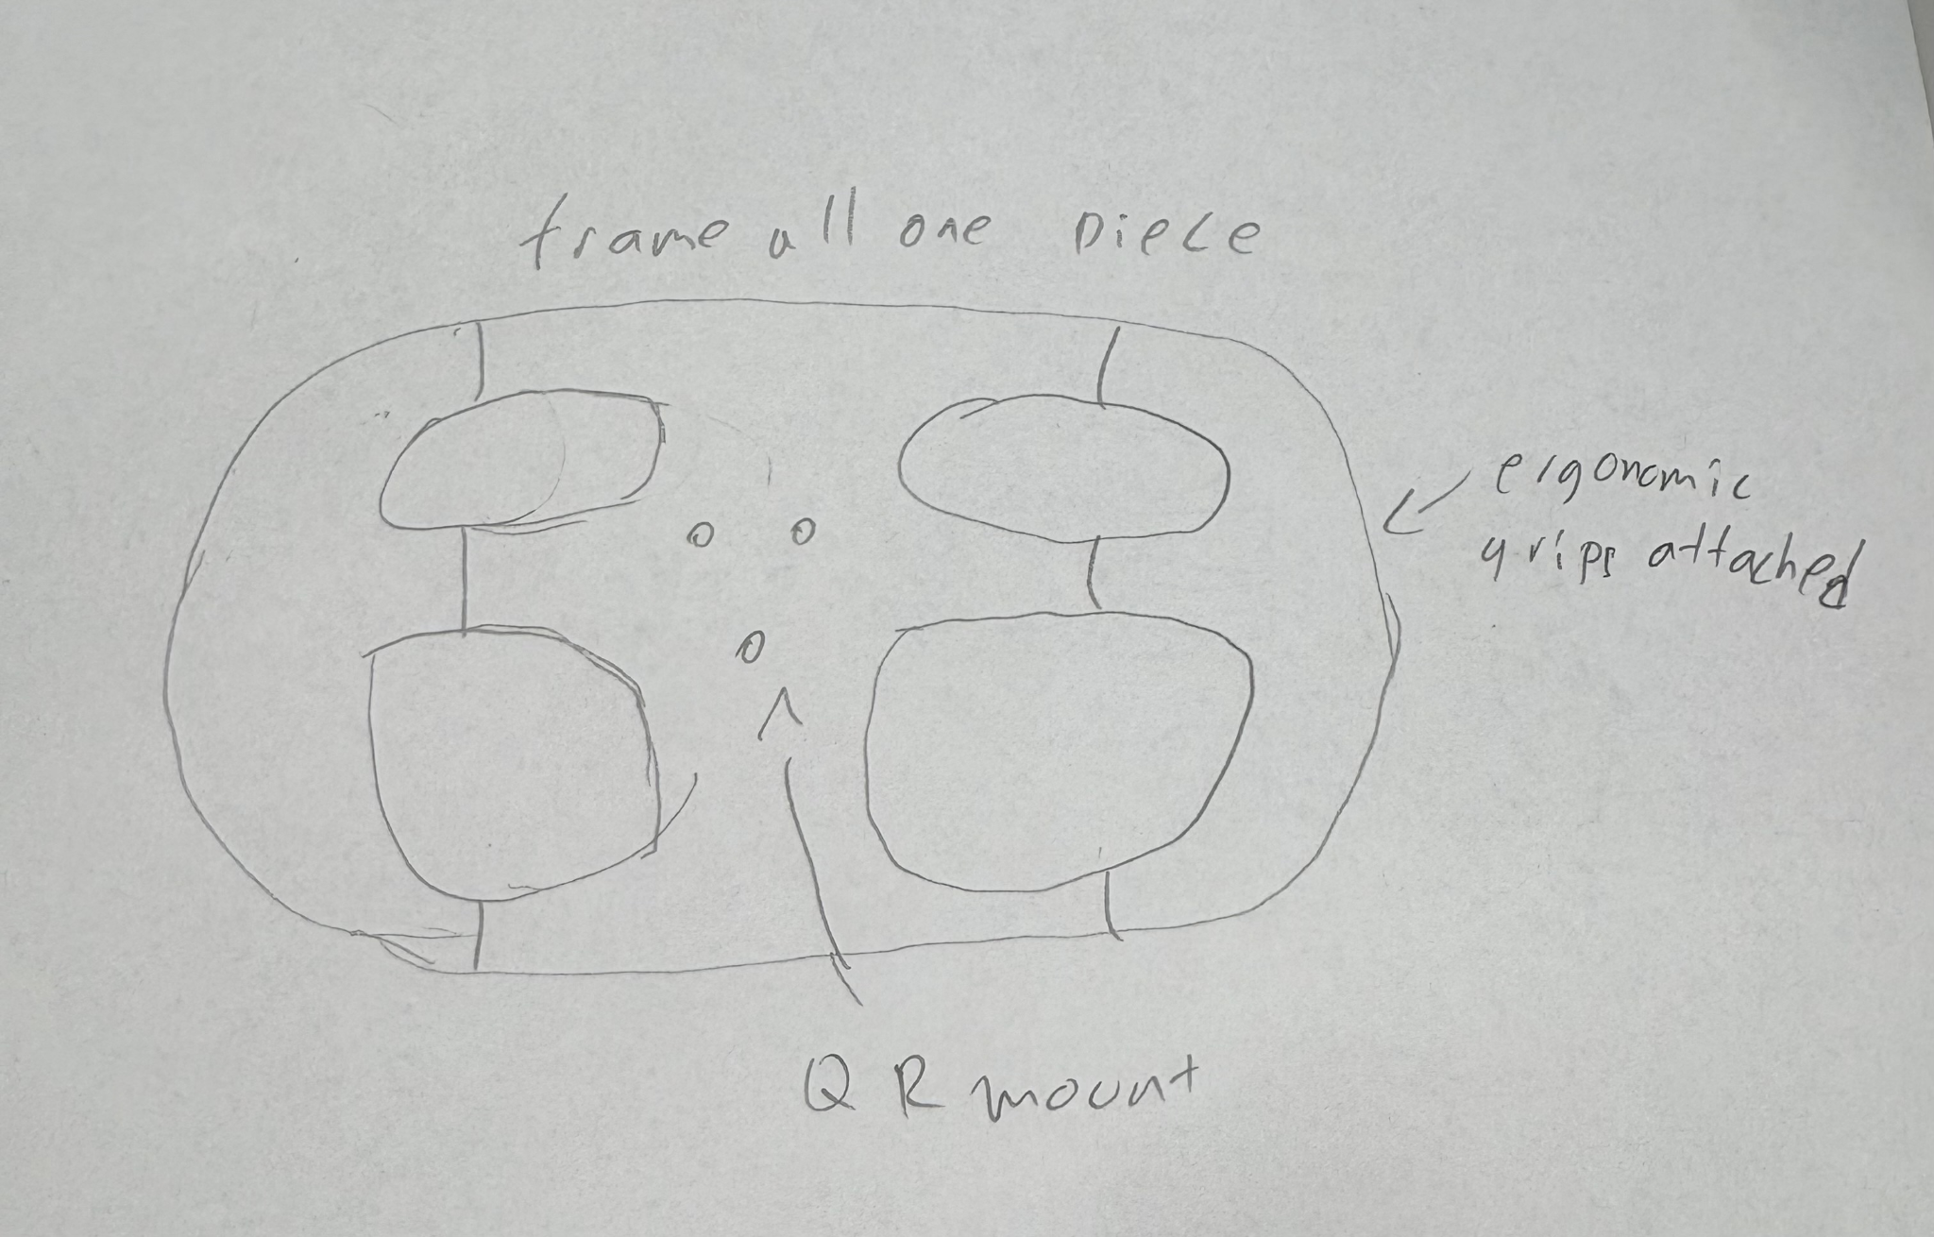
Design 01: One-Piece Closed Frame

Slide 7
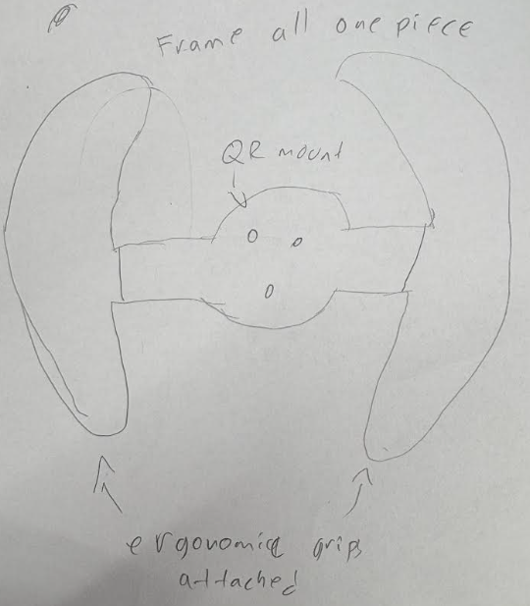
Design 02: One-Piece Open Frame

Slide 8
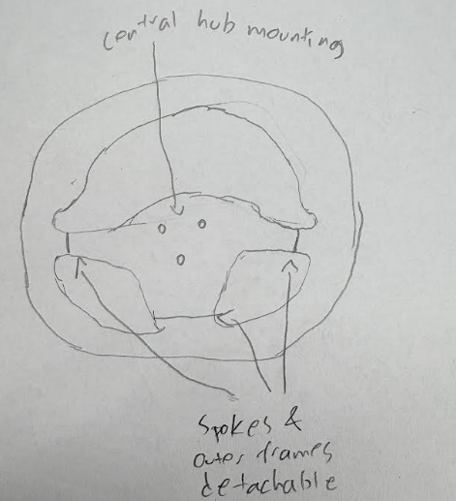
Design 03: Modular Circular Frame

Slide 9
Decision Matrix
Criteria | One-Piece Closed | One-Piece Open | Modular Circle
Structural stiffness / strength (25%) | 5 | 4 | 3
Manufacturability (20%) | 5 | 5 | 3
Ergonomics / driver control (20%) | 4 | 5 | 4
Mass efficiency (15%) | 4 | 5 | 3
Reliability / simplicity (10%) | 5 | 5 | 2
Packaging / component integration (10%) | 5 | 3 | 4
Weighted Score | 4.65 | 4.55 | 3.20

Slide 10
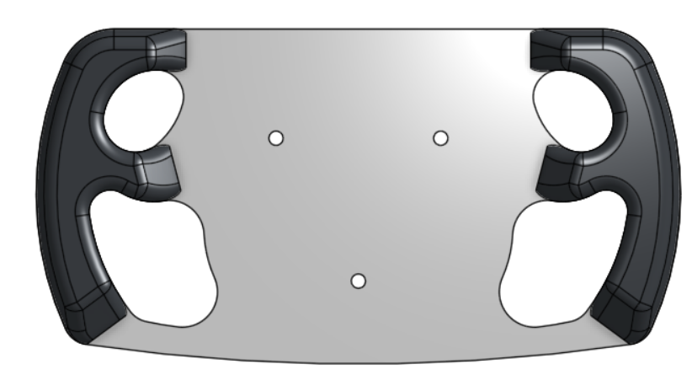
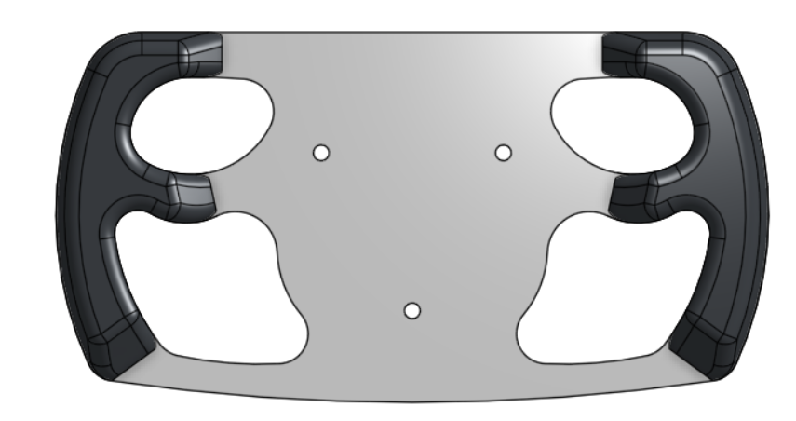
Version 01 vs Version 02
Larger cutouts, wider curves
Mass reduced by ~12.7%

Slide 11
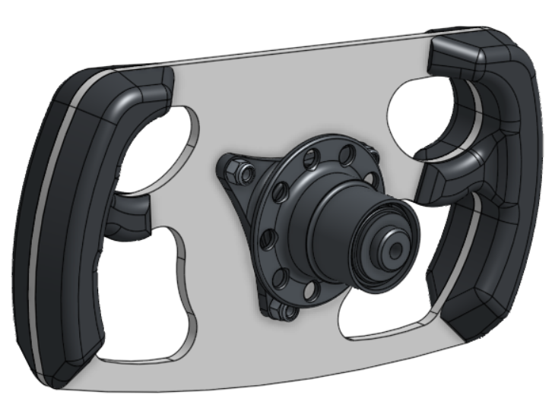
Rules
V.2.1.1 — Driver Accommodation
Vehicle must accommodate drivers from the 5th-percentile female through 95th-percentile male, including driver position, controls, and equipment.
V.3.3 — Steering Wheel
• Quick disconnect required
• Driver must operate the quick disconnect in the normal driving position with gloves on
• Continuous, near-circular or near-oval outer perimeter
• Straight outer sections permitted; concave outer sections are not
• “H,” “Figure 8,” and cutout outer-perimeter wheels are prohibited
T.1.4.4
The steering wheel must remain below the top-most point of the Front Hoop in every operational position.
V.3.2.8 / T.8.2
Steering-system fasteners are Critical Fasteners.
Continuous outer perimeter
Internal lightening openings
Centered Lifeline QR interface, could be quickly changed to Racetech
No concave outer perimeter sections

Slide 12

Ergonomics
Secure two-hand grip while wearing racing gloves
Adequate finger clearance around the aluminum structure
Rounded hand-contact surfaces
Neutral wrist position at primary grip locations
Easy thumb/finger repositioning
Unobstructed quick-release access
STRUCTURAL PLATE = strength + stiffness
SEPARATE GRIPS = comfort + friction + driver-specific refinement

Slide 13
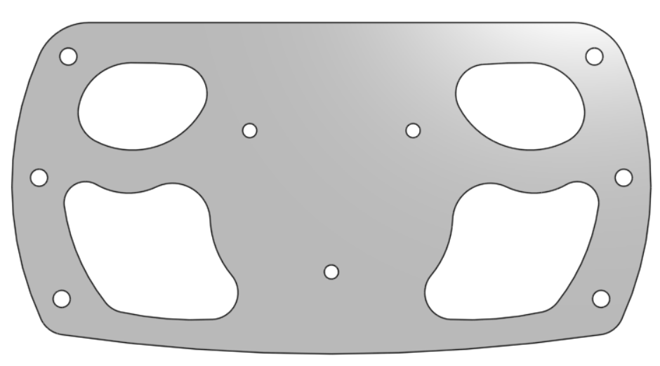
Material Selection: 7075-T6 Aluminum
Why 7075-T6?
High strength-to-weight ratio
Higher yield strength than common aluminum alloys enables a thin, lightweight structural plate while retaining low density
Machinable with conventional equipment
Supports a thin structural plate architecture
FEA Material Model:
Young’s Modulus: 71.7 GPa
Poisson’s Ratio: 0.33
Yield Strength: ≈ 503 MPa
Density: 2810 kg/m³

Slide 14
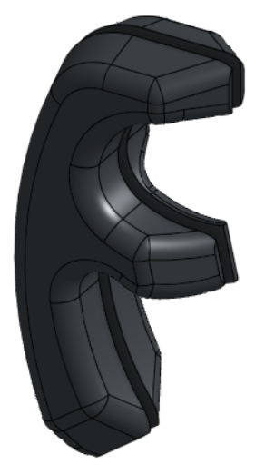
Material Selection: TPU 95A
Why TPU 95A?
High-friction surface improves grip with racing gloves
Slight compliance improves comfort and reduces pressure points
Firm enough to avoid excessive deformation during steering
Durable and abrasion-resistant
Easily 3D printed into complex ergonomic geometry
Enables rapid design iteration for different drivers
Grip Design Role:
Non-structural component; aluminum frame carries steering loads
Rounded profile distributes hand pressure over a larger area
Contoured thumb support improves grip security
Replaceable independently from the aluminum frame
Geometry can be adjusted based on driver feedback
Screws into frame

Slide 15
Load Cases
IN-PLANE STEERING TORQUE:
135 Nm
Tangential hand forces create torque about the steering-column axis
Primary response: In-plane shear/torsion
TWO-HAND OUT-OF-PLANE:
400 N (200 N each side)
Symmetric force perpendicular to the wheel face.
Primary response: Plate bending
ONE-HAND OUT-OF-PLANE:
200 N
Load at one grip only
Primary response: Asymmetric bending + local plate twisting
Values determined through online research
Target for yield FOS ≥ 2.0 in extreme cases

Slide 16
First-Principles Load Check
Given
F = 200 N
L = 104 mm = 0.104 m
t = 4 mm
b ≈ 50 mm effective ligament
Yield strength = 503 MPa
Bending moment
M = F × L
M = 200 N × 0.104 m
M = 20.8 N·m
Convert:
M = 20,800 N·mm
Second moment of area
I = b × t³ / 12
I = 50 × 4³ / 12
I = 50 × 64 / 12
I ≈ 266.7 mm⁴
Distance to outer fiber
c = t / 2
c = 4 / 2
c = 2 mm
Bending stress
σ = M × c / I
σ = 20,800 × 2 / 266.7
σ ≈ 156 MPa
Yield factor of safety
FOS = Yield strength / bending stress
FOS = 503 / 156
FOS ≈ 3.22
This approximates the loaded side of the wheel as a rectangular cantilever, does not capture the full 2D load path or stress concentrations and is therefore used as an independent order-of-magnitude check on the FEA.

Slide 17
FEA Methodology
Model
ANSYS Mechanical
Linear Static Structural
7075-T6 aluminum
Support
QR mounting interface modeled as rigidly constrained to approximate attachment to the steering hub.
Loads
Driver forces distributed across representative hand-contact regions rather than mathematical point loads.
Outputs
Max von Mises stress
Max total deformation
Yield FOS
Hotspot location
Mesh: Used 2mm element size, 1mm around all holes/cutouts. This was the smallest possible size without reaching node limit for student plan.
Limitations: Linear-elastic, static loading, rigid QR approximation, nominal material properties, grip stiffness neglected, fatigue/impact/manufacturing defects not modeled

Slide 18
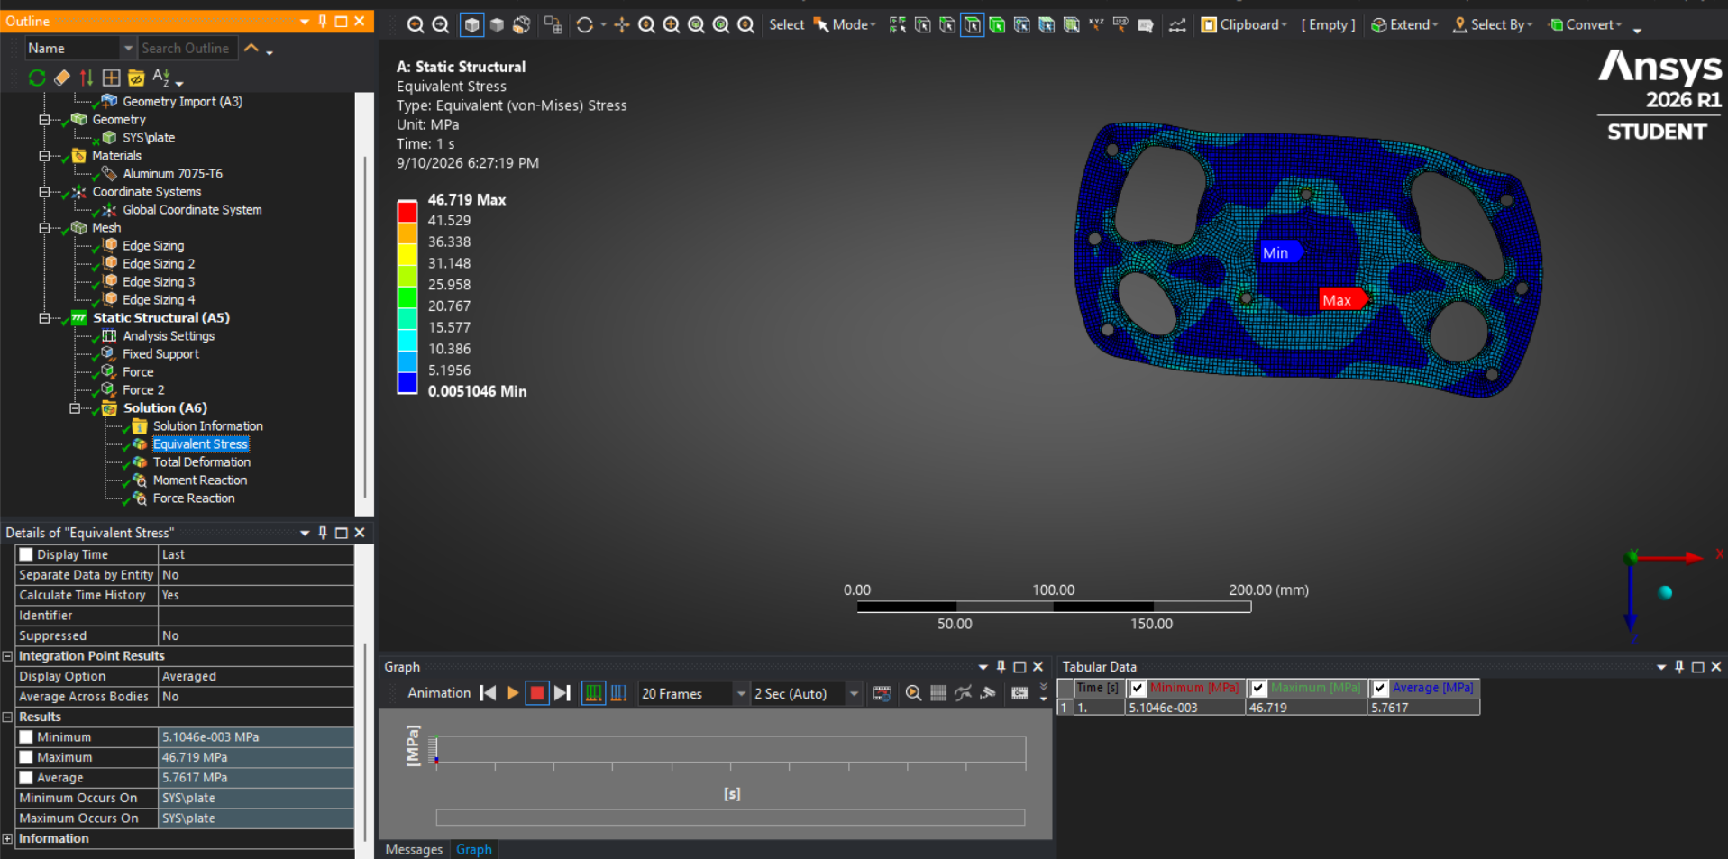
V1: In-Plane Steering Torque Test
von Mises: 46.72 MPa
Yield strength: 503 MPa
FOS ≈ 10.76

Slide 19
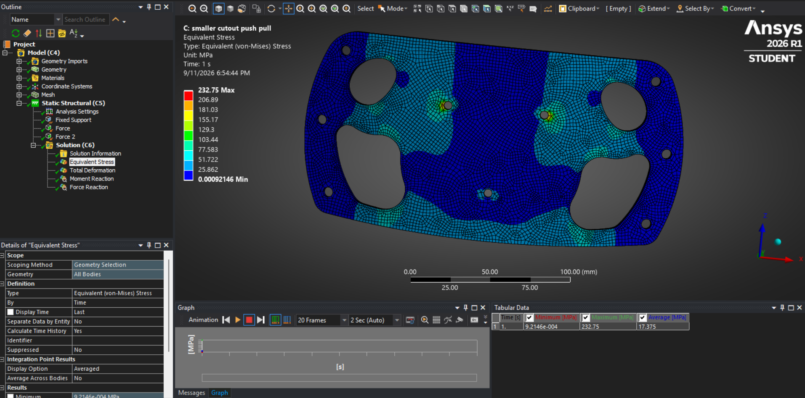
V1: Two-Hand Out-of-Plane Test
von Mises: 232.75MPa
Yield strength: 503 MPa
FOS ≈ 2.16

Slide 20
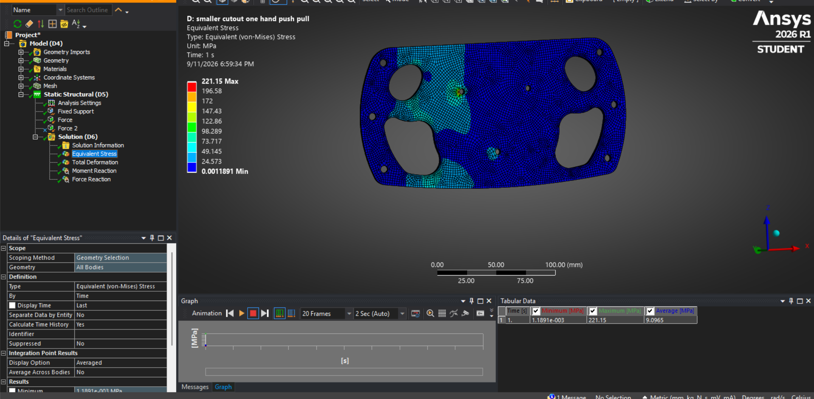
V1: One-Hand Out-of-Plane Test
von Mises: 221.15MPa
Yield strength: 503 MPa
FOS ≈ 2.27

Slide 21
All FOS > 2, but the design could still be improved

Slide 22
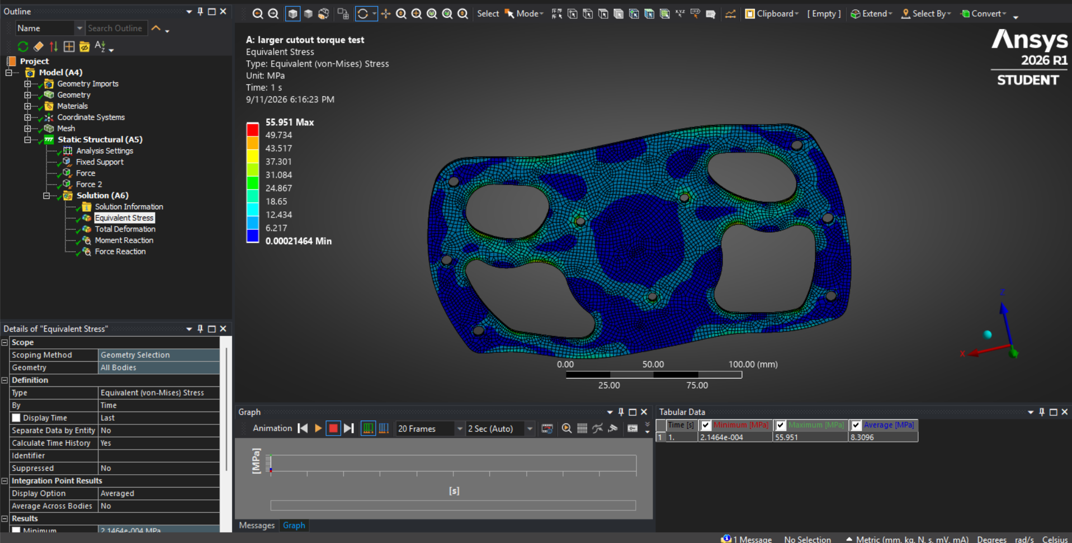
V2: In-Plane Steering Torque Test
von Mises: 55.95MPa
Yield strength: 503 MPa
FOS ≈ 8.99

Slide 23
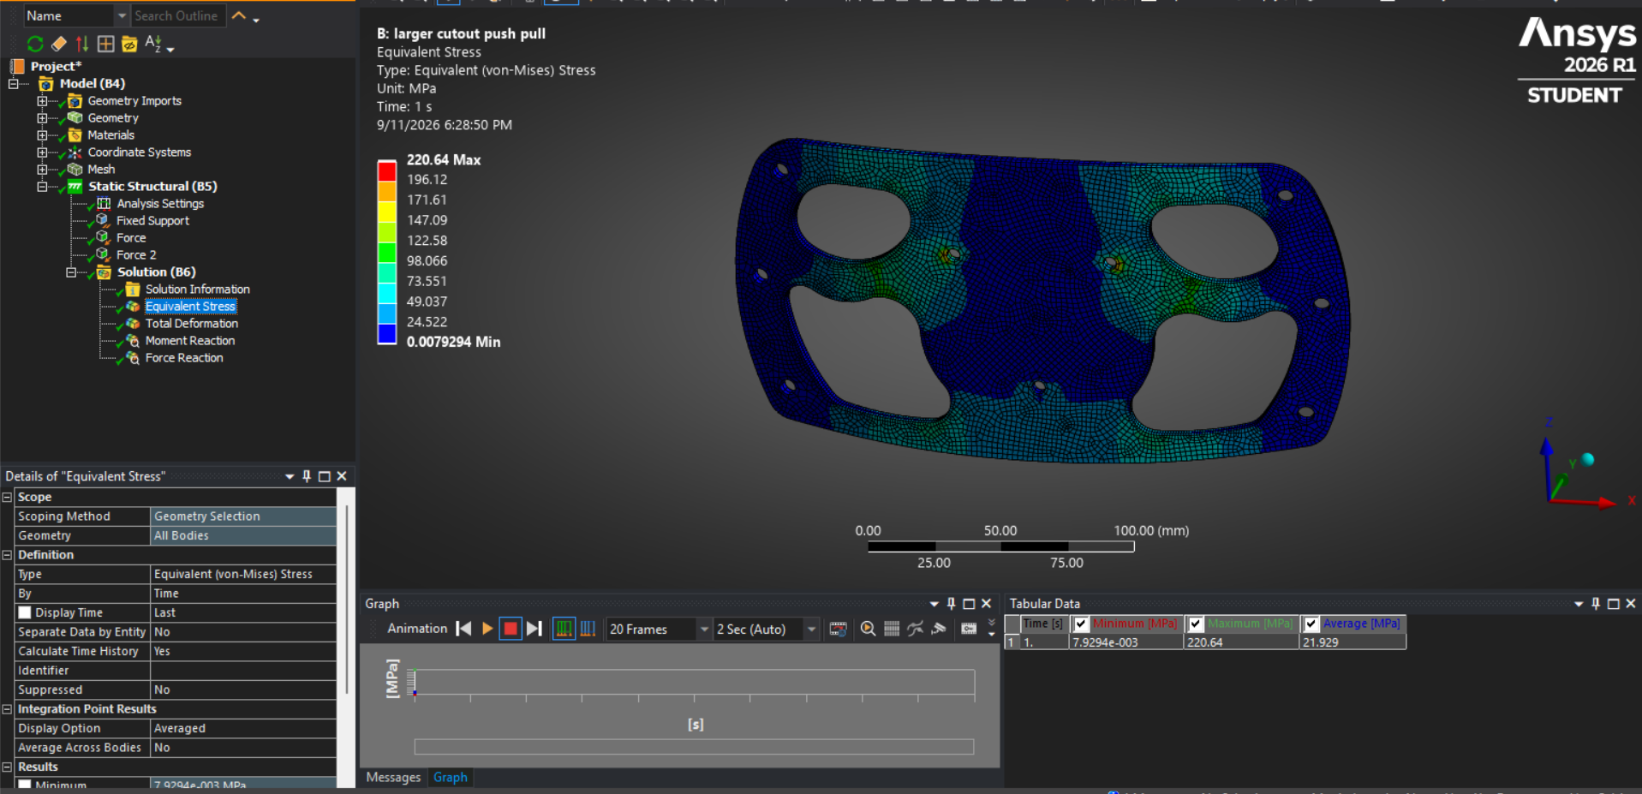
V2: Two-Hand Out-of-Plane Test
von Mises: 220.64 MPa
Yield strength: 503 MPa
FOS ≈ 2.28

Slide 24
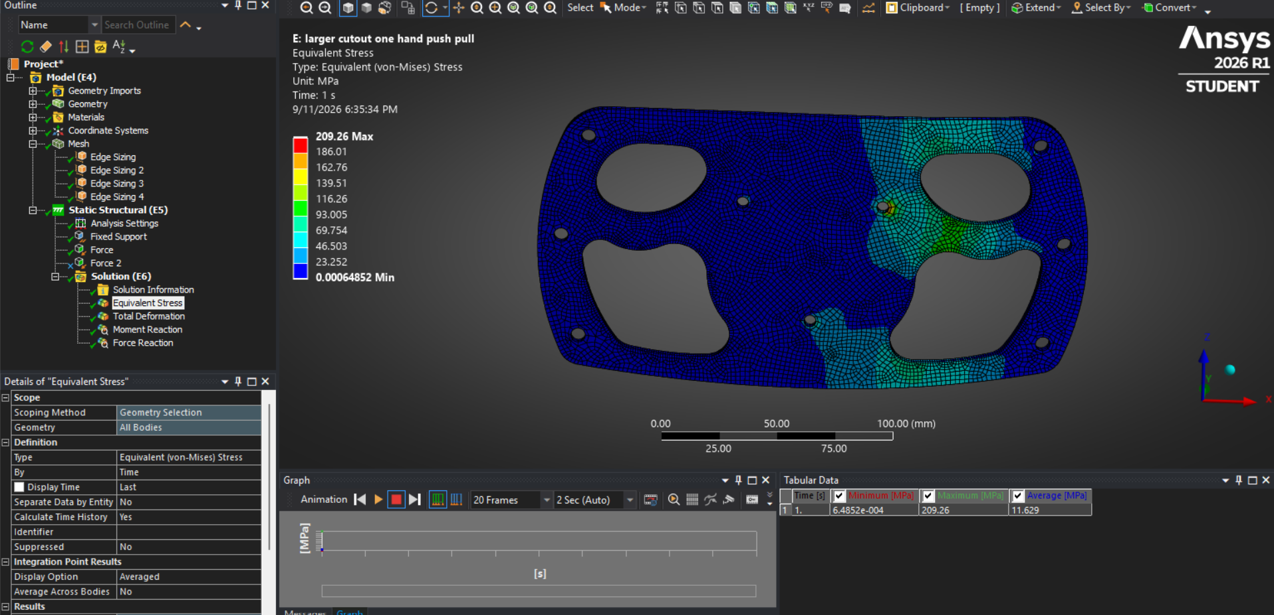
V2: One-Hand Out-of-Plane Test
von Mises: 209.26 MPa
Yield strength: 503 MPa
FOS ≈ 2.40

Slide 25
Version 2 FEA Summary
Case | Load | Max stress | Max deformation | Yield FOS | Result
Steering torque | 135 Nm | 55.95 MPa | 0.064 mm | 8.99 | PASS
Two-hand OOP | 400 N | 220.64 MPa | 1.934 mm | 2.28 | PASS
One-hand OOP | 200 N | 209.26 MPa | 1.369 mm | 2.40 | PASS

Slide 26
Ergonomic Validation Plan
3D print a 1:1 full scale prototype
Test with various drivers wearing racing gloves
Measure finger clearance, grip comfort, wrist angle, grip security, QR accessibility, hand repositioning
Work with driver feedback to redesign then test again, iterate until final
For further customization:
Have drivers hold clay with racing gloves on so it molds to their hand shapes
3D scan clay molds and adapt the scans to 3D printable grips that fit the frame.

Slide 27
Manufacturing Plan
Start with 4 mm 7075-T6 plate
Waterjet outer profile and large openings for efficiency
CNC machine smaller holes for better accuracy
Deburr and radius edges(0.5mm edge break/roundover)
Dimensional inspection
Optional anodizing
3D print grips

Slide 28
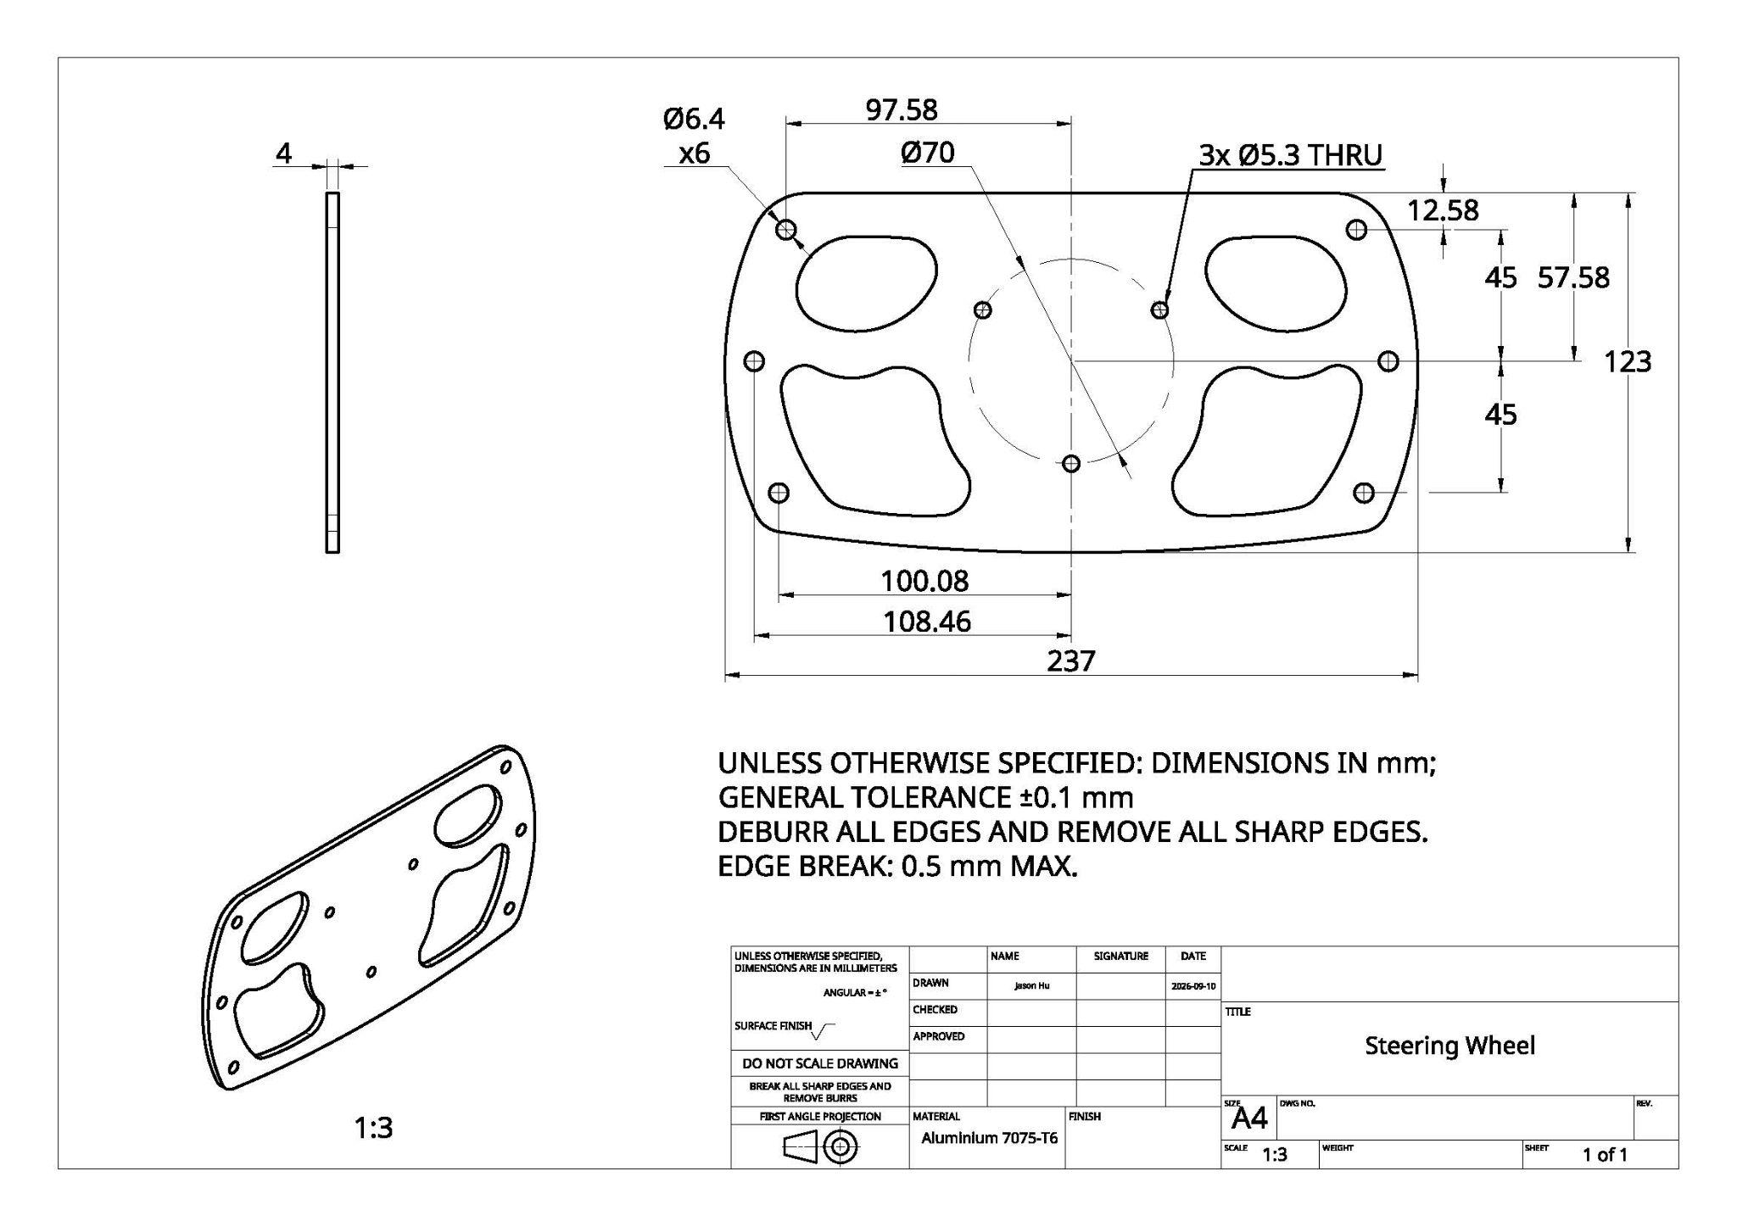

Slide 29
Assembly, BOM, Cost & Serviceability
Component | Material | Qty. | Manufacturing Process | Est. Mass | Est. Cost
Structural Plate | 4 mm 7075-T6 | 1 | Waterjet + CNC | ~219g | $75-125
Grip | TPU | 4 | 3D print | ~60g | $10-20
Total estimates:
Mass: ~279 g
Cost: $85-$145
Serviceability:
QR hardware accessible
Grips replaceable, fasteners inspectable
Plate easy to remanufacture

Slide 30
Physical Testing Plan
Mount wheel using actual QR or a rigid QR-representative fixture
Apply force at defined grip locations using a load cell / force gauge
Increase load in controlled increments
Measure grip displacement with a dial indicator
Compare measured load–displacement slope to FEA
Unload completely
Measure residual deformation
Inspect plate, grips, QR, and fasteners
Pass Criteria: No visible cracking, no permanent deformation, no fastener loosening, QR remains functional
Compare measured stiffness, k = F/δ, with the predicted displacement from ANSYS

Slide 31
Future Improvements
Replace assumed loads with vehicle-specific measured loads.
Run FEAs with finer meshes
Optimize the geometry further
Improve quick-release boundary condition(don’t assume QR interface fixed)
Add fatigue and cyclic loading
Analyze TPU grip as well
Do a tolerance/inspection drawing

